Slide 1
Python & Artificial intelligence

Slide 2
AGENDA
Introduction of Ai and Python.
Setup Python Enviromet in System.
Basic Python variable and data type
ML life cycle with Usecase.

Slide 3
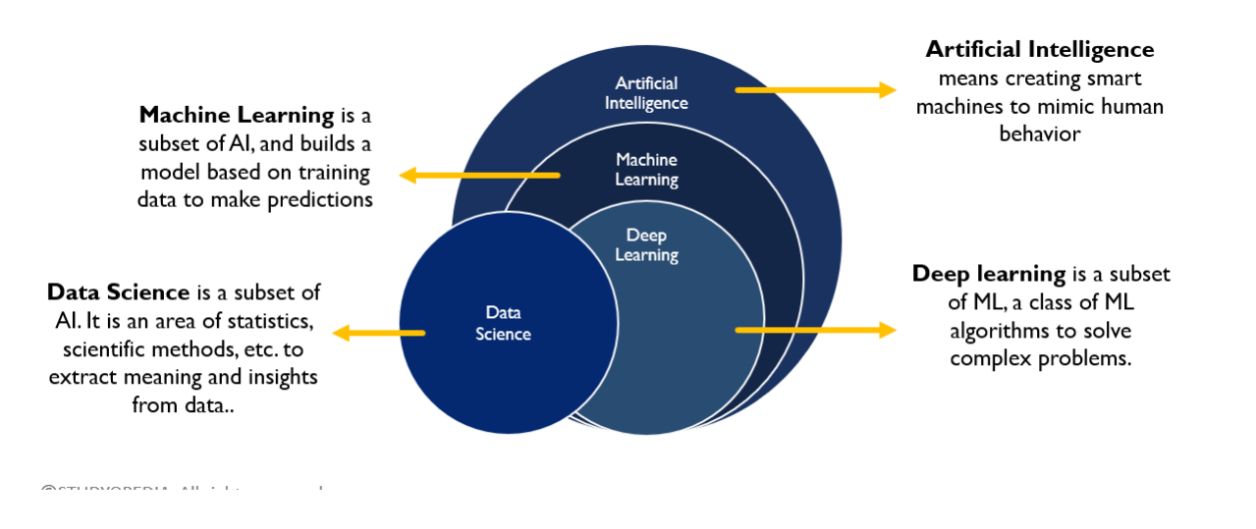
AI Vs ML Vs DL Vs DS

Slide 4
Artificial Intelligence - Ai
Artificial Intelligence (AI) is the science of making computers smart by enabling them to learn, and solve problems. It mimics human intelligence, allowing machines to understand, adapt, and make decisions.
Artificial intelligence leverages computers and machines to mimic The human mind to problem-solving and decision-making capabilities of the System.
Ai build the intelligent program that can mimic the human intelligence. eg. Smart home , Autonomous Vehicles ,Recommendation Systems ,Voice Assistants

Slide 5
Artificial Intelligence (AI) is the ability of a computer or machine to think, learn,
and make decisions like a human.
Face Recognition When your phone unlocks by recognizing your face — that is AI.
Voice Assistant When you talk to Google Assistant or Amazon Alexa and they understand and reply — that is AI.
YouTube Recommendations When YouTube suggests videos based on what you watch — that is AI.

Slide 6
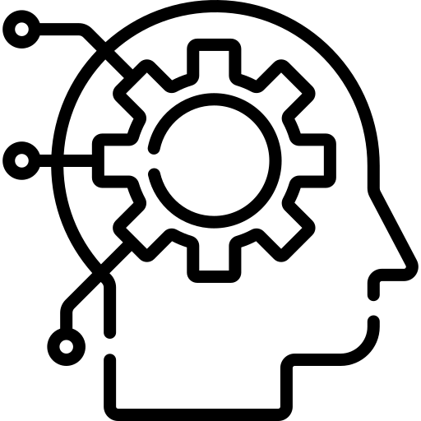
MACHINE LEARNING
Machine learning is a subfield of artificial intelligence (AI) that focuses on the development of algorithms and statistical models that enable computer systems to perform tasks without explicit programming. ML Algorithms learns patterns from the examples of task, to solve that particular task.
The primary goal of machine learning is to allow computers to learn and improve their performance on a specific task as they are exposed to more data over time.

Slide 7
DATA
Data refers to a information, or observations that can be collected, stored, and processed. It can be in the form of numbers, text, images, or any other format. it can reveal patterns, trends, and valuable information that can be used to make informed decisions or draw conclusions.
TEAM | RUN | WICKETS | CENTURY | RESULT
India | 356 | 8 | 1 | Win
Pakistan | 242 | 4 | 1 | Lose
Shri Lanka | 258 | 6 | 1 | Win

Slide 8

DATA
DATA
STRUCTURE DATA
NON STRUCTURE DATA
SEMI STRUCTURE DATA
TABULAR DATA
TEXT DATA
IMAGE DATA
VIDEO DATA
AUDIO DATA
JSON
XML
HTML

Slide 9
SCOPE OF AI & DATA SCIENCE
E-commerce
Agriculture
Healthcare and Medicine
Robotics
Finance and Banking
Marketing and Advertising
Manufacturing and Industry
Transportation and Logistics

Slide 10
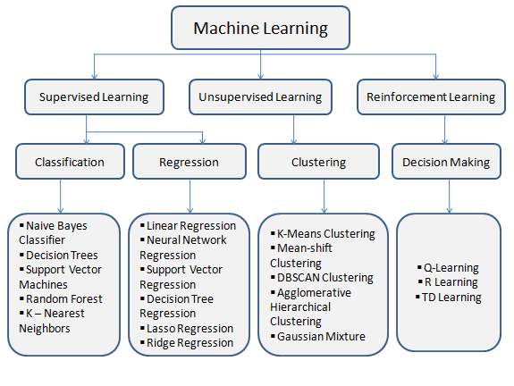
PARTITION OF MACHINE LEARNING

Slide 11
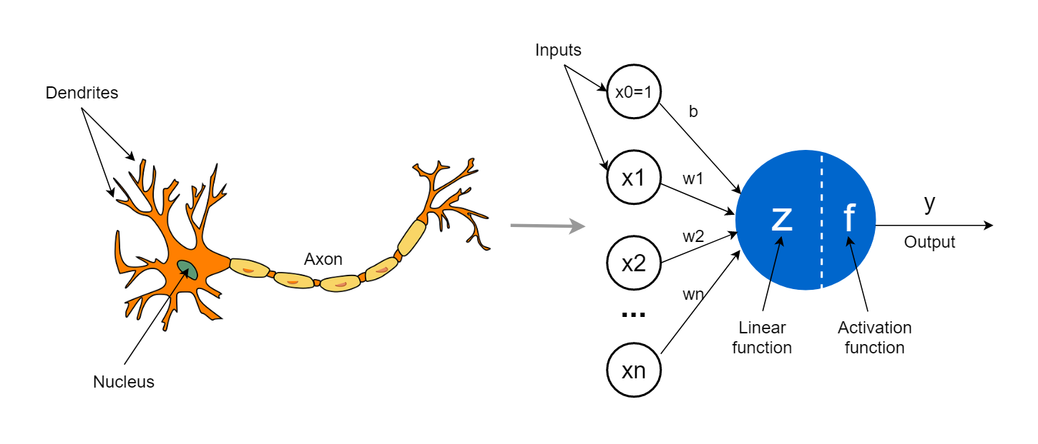
DEEP LEARNING
Deep Learning is a powerful subset of machine learning that involves training of Artificial Neural Networks to perform tasks, Deep learning simulates our brain. it is inspired by biological neuron concepts.

Slide 12
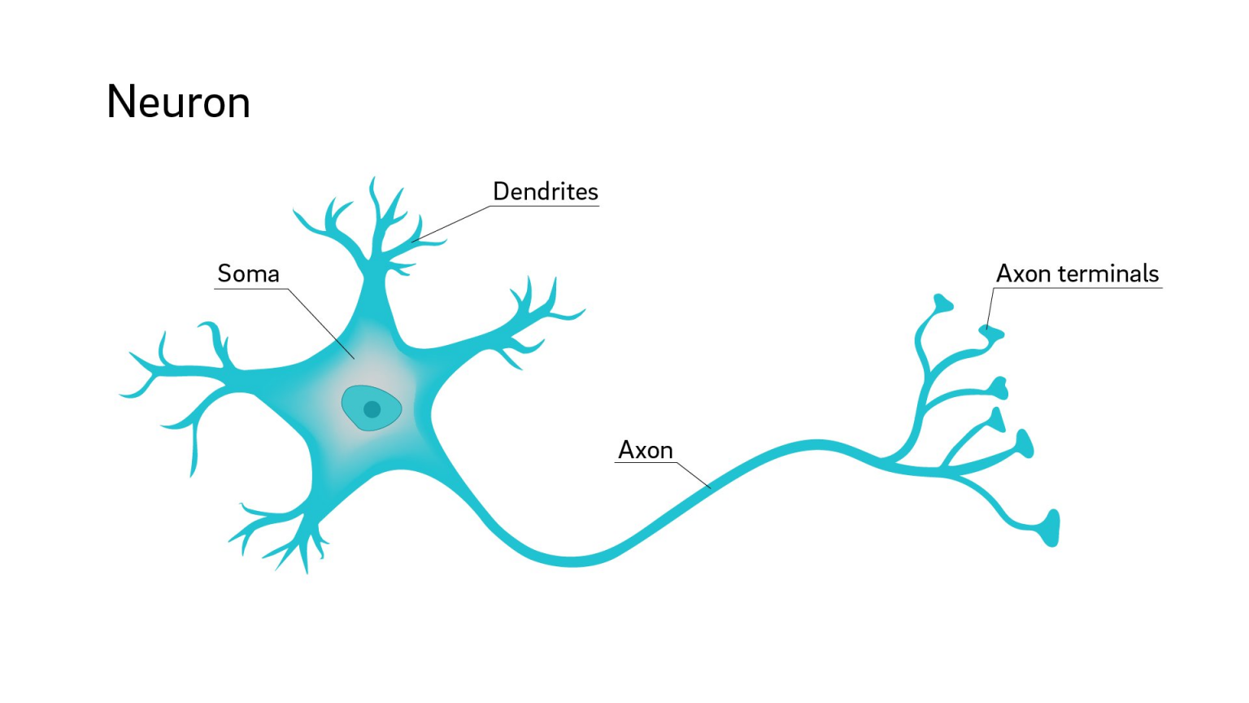
Biological Neural Networks
The brain is the control unit of the neural network, and it has different subunits that take care of vision, senses, movement, and hearing. The brain is connected with a dense network of nerves to the rest of the body’s sensors and actors. There are approximately 10¹¹ neurons in the brain.

Slide 13
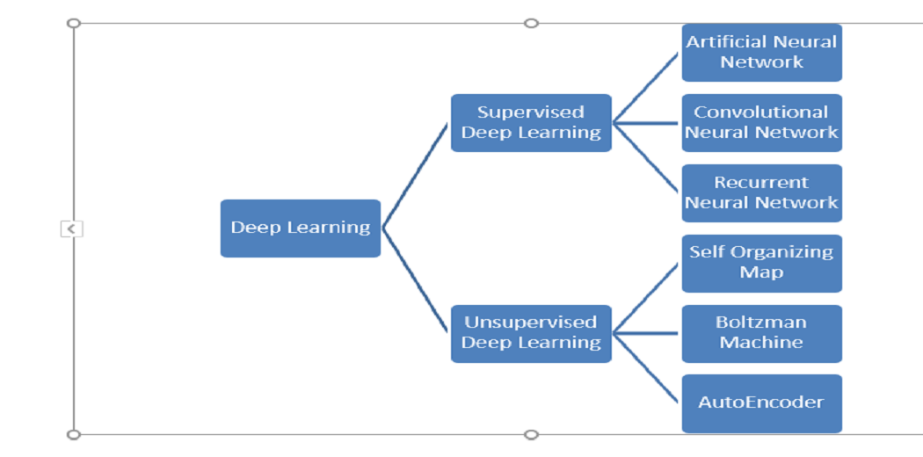
Deep Learning Partition

Slide 14
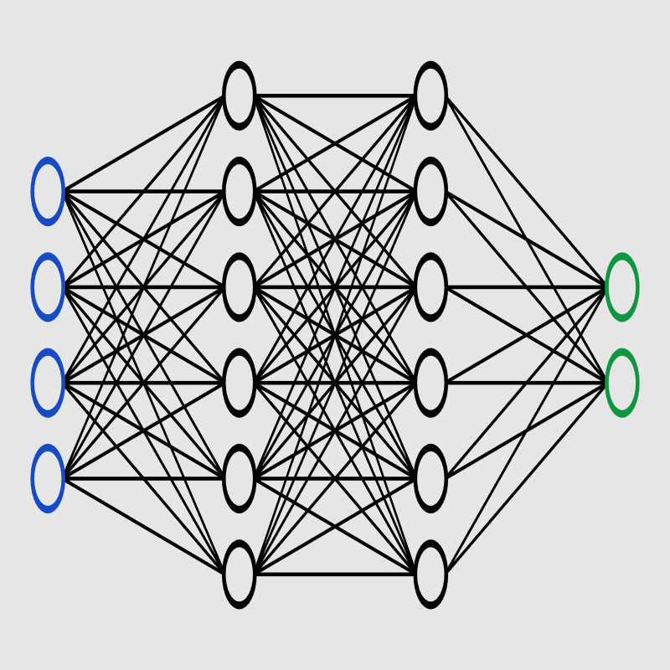
Artificial Neural Networks
The term "Artificial Neural Network" is derived from Biological neural networks that develop the structure of a human brain. Similar to the human brain that has neurons interconnected to one another, artificial neural networks also have neurons that are interconnected to one another in various layers of the networks.

Slide 15
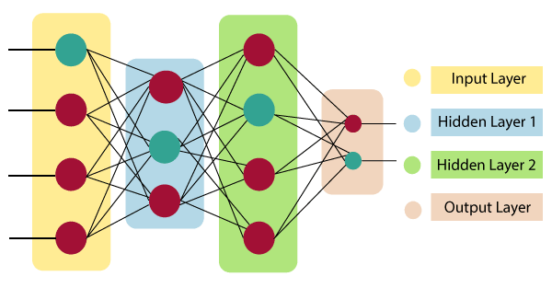
ANN LAYERS

Slide 16
Artificial Neural Networks Layers
INPUT
Gathers and feeds raw data into the network.
HIDDEN
Responsible to process the input Data.
OUTPUT
Produces the network's final prediction or outcome based on the processed input.

Slide 17
ANN Application
There are many applications of ANN. Some of them are :
Image Preprocessing and Character Recognition.
Forecasting.
Classification.
Regression.
Pattern Recognition.
Dimension Reduction.

Slide 18
Computer Vision
Computer vision is a field of study and technology that enables computers to interpret and make sense of visual information from the world, allowing them to understand and analyse images or videos like humans do.
Computer vision is a field of artificial intelligence that enables computers to interpret and make decisions based on visual data from the world, such as images or videos.

Slide 19
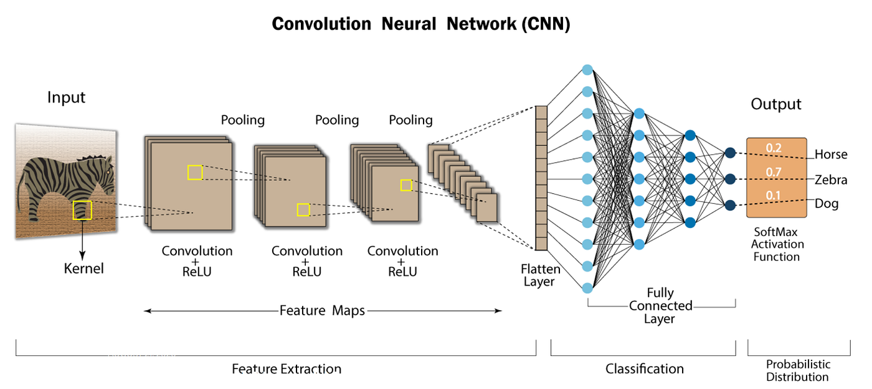
Convolutional Neural Networks

Slide 20
Convolutional Neural Networks Use cases :
Facial Recognition
Object Detection
Visual Search
Autonomous vehicle
Agricultural Monitoring
Medical Imaging
Retail Analytics
Automated Quality Control
Gesture Recognition

Slide 21
Natural Language Processing
Natural Language Processing (NLP) is a branch of artificial intelligence that focuses on the interaction between computers and human languages. It involves the development of algorithms and computational models to enable machines to understand, interpret, and generate human language.
NLP used to solve a wide range of tasks and applications, including :
Text Understanding
Sentiment Analysis
Question Answering
Language Generation
Speech Recognition
Text Summarization
Named Entity Recognition

Slide 22
NLP Components
NLU (Natural Language Understanding):
Definition: NLU focuses on the machine's ability to understand and interpret human language. It involves extracting meaning and intent from the input text, enabling the system to comprehend and respond appropriately.
Tasks: NLU encompasses tasks such as sentiment analysis, named entity recognition, part-of-speech tagging
NLG (Natural Language Generation):
Definition: NLG involves the machine's ability to generate human-like text or speech based on data or instructions provided to it. NLG systems aim to produce coherent and contextually relevant language output.
Tasks: NLG is used in various applications, including text summarization, content creation, chatbots, and report generation. It converts structured data into natural language, making it understandable for humans.

Slide 23
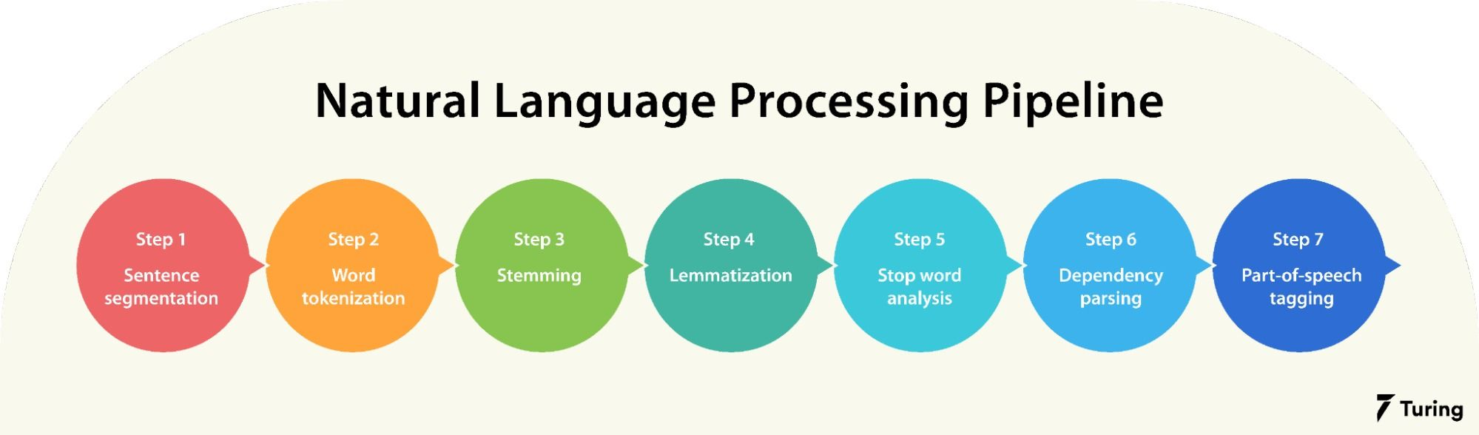
NLP Data Processing Pipeline

Slide 24
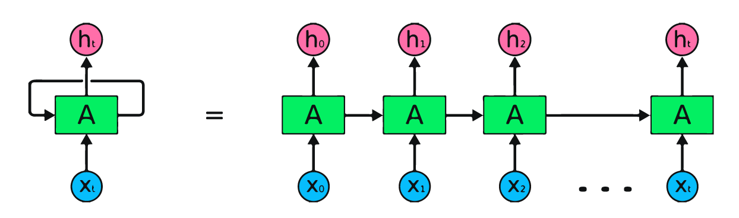
Recurrent Neural Networks
RNN (Recurrent Neural Network): A type of artificial neural network designed for sequential data processing, capable of retaining memory and considering previous inputs to influence the current output.

Slide 25
Recurrent Neural Networks Use Cases :
Natural Language Processing
Speech Recognition
sentiment analysis
Time Series Prediction
Handwriting Recognition
Music Composition
Text Generation
Text Summarization
Chat Bot Building

Slide 26
AI Vs ML Vs DL Vs DS

Slide 27
THANK YOU
😊

